Slide 1
ISO31000:2018 – RISK MANAGEMENT – HOW TO IMPLEMENT
A Risk Practitioners Guide To ISO31000:2018
https://www.theirm.org/media/3513119/IRM-Report-ISO-31000-2018-v3.pdf

Slide 2
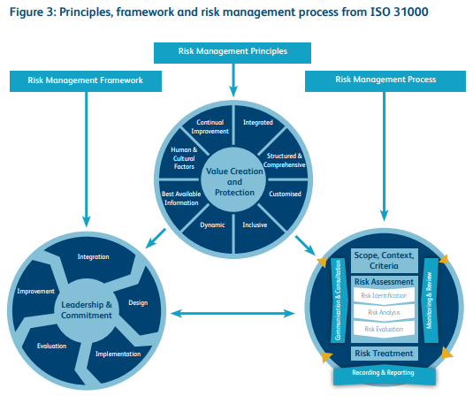
ISO31000:2018 – RISK MANAGEMENT – HOW TO IMPLEMENT

Slide 3
ISO31000:2018 – RISK MANAGEMENT – HOW TO IMPLEMENT
Successful implementation of a risk management initiative is an ongoing process that involves working through 10 activities below on a continuous basis. These activities relate to:
(1) Plan;
(2) Implement;
(3) Measure; and
(4) Learn.

Slide 4
ISO31000:2018 – RISK MANAGEMENT – HOW TO IMPLEMENT
Plan:
1. Identify intended benefits of the RM initiative and gain board support
2. Plan the scope of the RM initiative and develop common language of risk
3. Establish the RM strategy, framework and the roles and responsibilities

Slide 5
ISO31000:2018 – RISK MANAGEMENT – HOW TO IMPLEMENT
Implement:
4. Adopt suitable risk assessment tools and an agreed risk classification system
5. Establish risk benchmarks (risk criteria) & undertake risk assessments
6. Determine risk appetite and risk tolerance levels and evaluate the existing controls

Slide 6
ISO31000:2018 – RISK MANAGEMENT – HOW TO IMPLEMENT
Measure:
7. Evaluate effectiveness of existing controls and introduce improvements
8. Embed risk-aware culture and align RM with other activities in the organization

Slide 7
ISO31000:2018 – RISK MANAGEMENT – HOW TO IMPLEMENT
Learn
9. Monitor and review risk performance indicators to measure RM contribution
10. Report risk performance in line with obligations and monitor improvement

Slide 8
ISO31000:2018 – RISK MANAGEMENT – HOW TO IMPLEMENT
Although ISO 31000 covers the full scope of requirements for a management system, it is for the organization to convert those requirements into a checklist and action plan.
END

